Slide 1
Chapter 9
Object-Oriented Analysis and Modeling Using the UML
Notes:
This repository of slides is intended to support the named chapter. The slide repository should be used as follows:
Copy the file to a unique name for your course and unit.
Edit the file by deleting those slides you don’t want to cover, editing other slides as appropriate to your course, and adding slides as desired.
Print the slides to produce transparency masters or print directly to film or present the slides using a computer image projector.
Each slide includes instructor notes. To view those notes in PowerPoint, click-left on the View Menu; then click left on Notes View sub-menu. You may need to scroll down to see the instructor notes.

Slide 2
Objectives
Define object modeling and explain its benefits.
Recognize and understand the basic concepts and constructs of object modeling.
Define the UML and its various types of diagrams.
Evolve a business requirements use-case model into a system analysis use-case model.
Construct an activity diagram.
Discover objects and classes, and their relationships.
Construct a class diagram.
Notes:
No additional notes.

Slide 3
Introduction to Object Modeling
Object-oriented analysis (OOA) – an approach used to
study existing objects to see if they can be reused or adapted for new uses
define new or modified objects that will be combined with existing objects into a useful business computing application
Object modeling – a technique for identifying objects within the systems environment and the relationships between those objects.
Notes:
Teaching Notes
The object modeling technique prescribes the use of methodologies and diagramming notations that are completely different from the ones used for data modeling and process modeling.
In the late 1980s and early 1990s many different object-oriented methods were being used throughout the industry. The most notable of these were Grady Booch’s Booch Method, James Rumbaugh’s Object Modeling Technique (OMT), and Ivar Jacobson’s Object-Oriented Software Engineering (OOSE).

Slide 4
Introduction to the UML
Unified Modeling Language (UML) – a set of modeling conventions that is used to specify or describe a software system in terms of objects.
The UML does not prescribe a method for developing systems—only a notation that is now widely accepted as a standard for object modeling.
Notes:
Teaching Notes
In 1994 Grady Booch and James Rumbaugh joined forces to merge their respective object-oriented development methods with the goal of creating a single, standard process for developing object-oriented systems.
Ivar Jacobson joined them in 1995 and the three altered their focus to create a standard object modeling language instead of a standard object-oriented approach or method.
Referencing their own work as well as countless others in the OO industry, the Unified Modeling Language (UML) version 1.0 was released in 1997. UML version 2.0 is expected to be released in late 2000.
At the time of this writing, Booch, Rumbaugh, and Jacobson have developed and marketed an object modeling methodology called the Unified Method or Objectory.

Slide 5
Objects & Attributes
Object – something that is or is capable of being seen, touched, or otherwise sensed, and about which users store data and associate behavior.
Person, place, thing, or event
Employee, customer, instructor, student
Warehouse, office, building, room
Product, vehicle, computer, videotape
Attribute – the data that represent characteristics of interest about an object.
Notes:
Teaching Notes
There are several concepts that object-oriented analysis is based on. Some of these concepts require a totally new way of thinking about systems and the development process. These concepts have presented a formidable challenge to veteran developers who must relearn how they have traditionally viewed systems.
Object-oriented approaches to systems development are concerned with identifying attributes that are of interest regarding an object. It is important to note that with advances in technology, attributes have evolved to include more than simple data characteristics. Today, objects may include newer attribute types, such as a bitmap or a picture sound, or even video.
Have students provide examples of objects and their attributes that exist in the classroom. For instance, pen is an object; color of ink is an attribute.

Slide 6
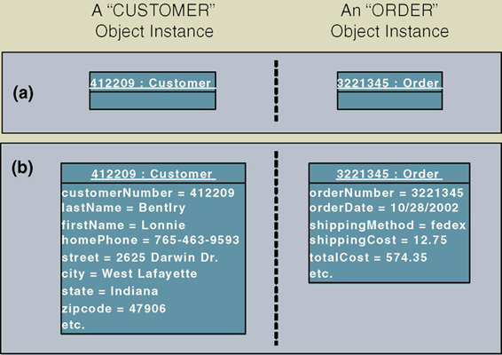
Objects & Object Instances
Object instance – each specific person, place, thing, or event, as well as the values for the attributes of that object.
Notes:
Teaching Notes
This figure depicts the symbol for representing an object instance using the UML modeling notation. An object is represented using a rectangle. The name of the object instance and its classification are underlined and appear at the top of the symbol. The attribute values for the object instance are optionally recorded within the symbol and are separated from the object name with a line.
The name of an object instance is the value of the attribute that uniquely identifies it. The attribute customer number, whose value is 412209, uniquely identifies that instance of customer. Thus, 412209 is the name of the object instance and customer is its classification.

Slide 7
Behavior & Encapsulation
Behavior – the set of things that the object can do that correspond to functions that act on the object’s data (or attributes).
In object-oriented circles, an object’s behavior is commonly referred to as a method, operation, or service.
Encapsulation – the packaging of several items together into one unit.
Notes:
Teaching Notes
In encapsulation, both attributes and behavior of the object are packaged together. The only way to access an object's attributes is through that object’s behaviors. No other object may perform that object’s behavior.
Have students identify the behaviors of a door, window, or VCR.

Slide 8
Object Classes
Object Class – a set of objects that share common attributes and behavior. Sometimes referred to as a class.
Notes:
No additional notes.

Slide 9
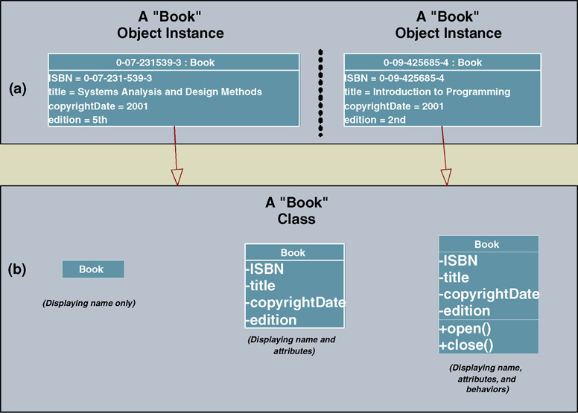
Representing Object Classes in the UML
Notes:
Teaching Notes
In UML an object class is represented using a rectangle symbol.
The object rectangle is divided into three portions.
The top portion contains the name of the class.
The middle portion contains the names of the attributes.
The lower portion contains the behaviors (or methods).
To simplify the appearance of a diagram, or to specify more details about a class, class symbols can be drawn without methods or attributes, or the attribute portion can be expanded to include data types, lengths, etc. The appearance depends on what the author of the diagram is intending to communicate.

Slide 10
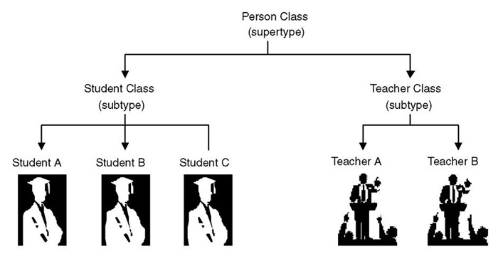
Inheritance
Inheritance – the concept wherein methods and/or attributes defined in an object class can be inherited or reused by another object class.
Notes:
Teaching Notes
Inheritance is a critical concept of OO. In fact for a programming language or DBMS to be considered OO, it must support inheritance. In inheritance, the child class inherits the attributes and methods from its parent class(s).

Slide 11
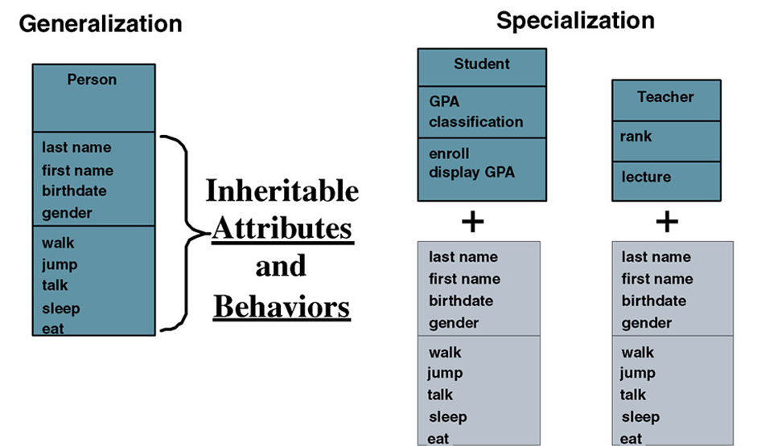
Inheritance (cont.)
Notes:
Teaching Notes
The terms Generalization and Specialization will be defined on the next slide.
Walk the students through this diagram.
The Person object has an attribute last name. Therefore the Student and Teacher objects that are based on Person also have an attribute last name as well as their own attributes (GPA or rank).
The Person object has a method walk. Therefore Student and Teach also have a method walk as well as their own methods (enroll or lecture).

Slide 12
Generalization/Specialization, Supertype, and Subtype
Generalization/specialization – technique wherein attributes and behaviors common to several types of object classes are grouped (or abstracted) into their own class, called a supertype.
Supertype – an entity that contains attributes and behaviors that are common to one or more class subtypes. Also referred to as abstract or parent class.
Subtype – an object class that inherits attributes and behaviors from a supertype class and may contain other attributes and behaviors unique to it. Also referred to as a child class and, if it exists at the lowest level of the inheritance hierarchy, as concrete class.
Notes:
Teaching Notes
The previous slide illustrates these terms.
The class supertype will have one or more one-to-one relationships to object class subtypes. These relationships are sometimes called “IS A” relationships (or “WAS A” or “COULD BE A”) because each instance of the supertype “is also an” instance of one or more subtypes.

Slide 13
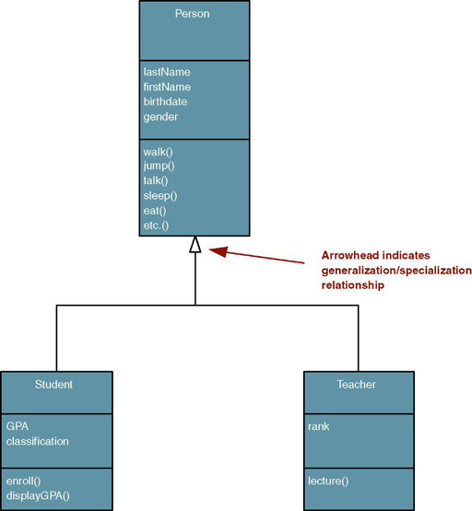
UML Representation of Generalization/Specialization
Notes:
Teaching Notes
Have students identify what attributes and methods are inherited by the STUDENT and TEACHER classes.

Slide 14
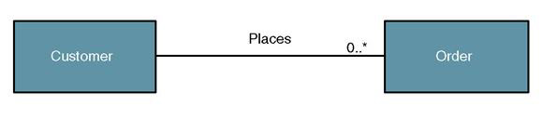
Object/Class Relationships
Object/class relationship – a natural business association that exists between one or more objects and classes.
Notes:
Teaching Notes
Objects and classes do not exist in isolation. The things they represent interact with and impact one another to support the business mission.
An object/class relationship is graphically illustrated in UML as a connecting line between two classes. This relationship is commonly referred to as an association. The line is labeled with a verb phrase that describes the association. All associations are implicitly bidirectional, meaning that they can interpreted in both directions.
The figure above shows the complexity or degree of each association. For example, in the above business assertions, we must also answer the following questions:
Must there exist an instance of CUSTOMER for each instance of ORDER? Yes!
Must there exist an instance of ORDER for each instance of CUSTOMER? No!
How many instances of ORDER can exist for each instance of CUSTOMER? Many!
How many instances of CUSTOMER can exist for each instance of ORDER? One!

Slide 15
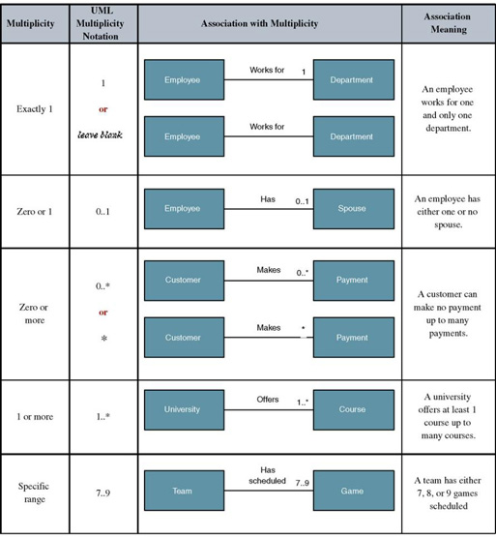
UML Multiplicity Notations
Multiplicity – the minimum and maximum number of occurrences of one object/class for a single occurrence of the related object/class.
Notes:
Teaching Notes
Because all associations are implicitly bidirectional, multiplicity must be defined in both directions for every association.

Slide 16
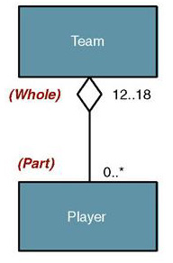
Aggregation
Aggregation – a relationship in which one larger “whole” class contains one or more smaller “parts” classes. Conversely, a smaller “part” class is part of a “whole” larger class
In UML 2.0 the notation for aggregation has been dropped
Notes:
Teaching Notes
Aggregation relationships do not support inheritance. Their benefit lies in the ability to send a message to the parent class and that message is automatically applied to all the child classes.
Have students provide other examples of objects where aggregation relationships are appropriate (car – or any bill of material, order-line item, etc.).

Slide 17
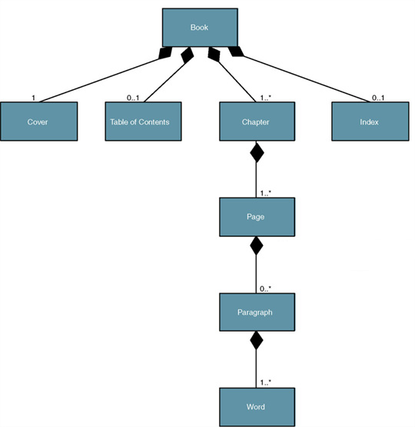
Composition
Composition – an aggregation relationship in which the “whole” is responsible for the creation and destruction of its “parts.” If the “whole” were to die, the “part” would die with it.
Notes:
Teaching Notes
All composition relationships are aggregation relationships. But not all aggregation relationships are composition relationships.
Ask students why composition is appropriate for the Book and Chapter classes but not for the Team class.

Slide 18
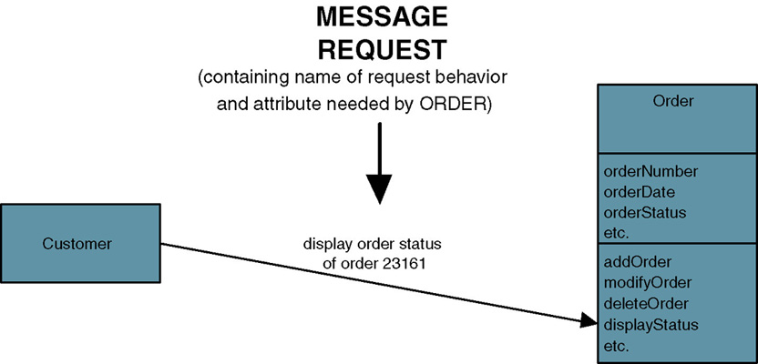
Messages
Message – communication that occurs when one object invokes another object’s method (behavior) to request information or some action
Notes:
Teaching Notes
The object sending a message does not need to know how the receiving object is organized internally or how the behavior is to be accomplished, only that it responds to the request in a well-defined way.
A message can be sent only between two objects that have an association between them.

Slide 19
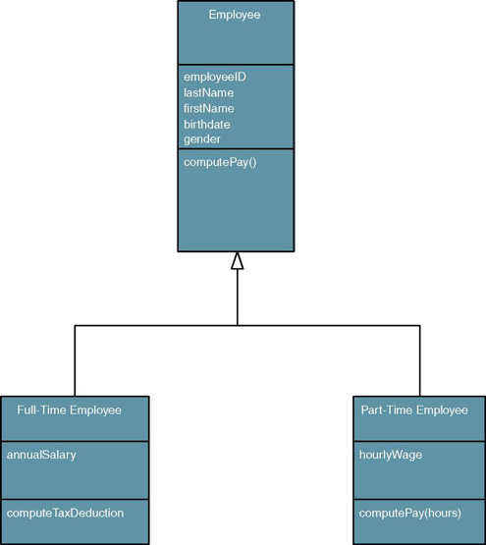
Polymorphism
Polymorphism – the concept that different objects can respond to the same message in different ways.
Override – a technique whereby a subclass (subtype) uses an attribute or behavior of its own instead of an attribute or behavior inherited from the class (supertype).
Notes:
Teaching Notes
Polymorphism supports reusability in that the same message can be sent to different objects and be interpreted different ways. For example, let’s say we have a method called “Compute Pay” and two objects named FULL-TIME EMPLOYEE and PART-TIME EMPLOYEE. The same “compute pay” message can be sent to both objects but how each object reacts/responds to the message is different. A full-time employee’s pay may be composed of a weekly salary (minus deductions) whereas a part-time employee only gets paid for the hours worked (minus deductions).
When the PART-TIME EMPLOYEE object receives a message to “compute pay,” it will override the behavior of the EMPLOYEE supertype and use its own behavior. But because of polymorphism, the object sending the message never knows the difference.

Slide 20
UML 2.0 Diagrams
Diagram | Description
Use Case | Depicts interactions between the system and external systems and users. In other words it graphically describes who will use the system and in what ways the user expects to interact with the system. The use-case narrative is used in addition to textually describe the sequence of steps of each interaction.
Activity | Depicts sequential flow of activities of a use case or business process. It can also be used to model logic with the system.
Class | Depicts the system's object structure. It shows object classes that the system is composed of as well as the relationships between those object classes.
Object | Similar to a class diagram, but instead of depicting object classes, it models actual object instances with current attribute values. The object diagram provides the developer with a "snapshot" of the system's object at one point in time.
State Machine | Models how events can change the state of an object over its lifetime, showing both the various states that an object can assume and the transitions between those states.
Composite Structure | Decomposes internal structure of class, component, or use case.
Notes:
Teaching Notes
As we study an overview of the systems analysis life cycle, three chapters will delve into the core UML diagrams:
Chapter 6 – FAST Requirements Analysis Phase
Use Case Diagrams
Chapter 9 – FAST Logical Design Phase
Activity Diagrams
System Sequence Diagrams (a high-level kind of Sequence Diagram)
Class Diagrams
Chapter 17 – FAST Physical Design Phase
Sequence Diagrams
Class Diagrams (with more detail)
State Machine Diagrams
Communication Diagrams
Component Diagrams
Deployment Diagrams

Slide 21
UML 2.0 Diagrams (cont.)
Diagram | Description
Sequence | Graphically depicts how objects interact with each other via messages in the execution of a use case or operation. It illustrates how messages are sent and received between objects and in what sequence.
Communication | (Collaboration diagram in UML 1.X) Depicts interaction of objects via messages. While a sequence diagram focuses on the timing or sequence of messages, a communication diagram focuses on the structural organization of objects in a network format.
Interaction Overview | Combines features of sequence and activity diagrams to show how objects interact within each activity of a use case.
Timing | Another interaction diagram that focuses on timing constraints in the changing state of a single object or group of objects. Especially useful when designing embedded software for devices.
Component | Depicts the organization of programming code divided into components and how the components interact.
Deployment | Depicts the configuration of software components within the physical architecture of the system's hardware "nodes."
Package | Depicts how classes or other UML constructs are organized into packages (corresponding to Java packages or C++ and .NET namespaces) and the dependencies of those packages.
Notes:
Teaching Notes
As we study an overview of the systems analysis life cycle, three chapters will delve into the core UML diagrams:
Chapter 6 – FAST Requirements Analysis Phase
Use Case Diagrams
Chapter 9 – FAST Logical Design Phase
Activity Diagrams
System Sequence Diagrams (a high-level kind of Sequence Diagram)
Class Diagrams
Chapter 17 – FAST Physical Design Phase
Sequence Diagrams
Class Diagrams (with more detail)
State Machine Diagrams
Communication Diagrams
Component Diagrams
Deployment Diagrams

Slide 22
The Process of Object Modeling
Modeling the functions of the system.
Finding and identifying the business objects.
Organizing the objects and identifying their relationships.
Notes:
Teaching Notes
These are object-oriented analysis general activities

Slide 23
Construction the Analysis Use-Case Model
System analysis use case – a use case that documents the interaction between the system user and the system. It is highly detailed in describing what is required but is free of most implementation details and constraints.
Identify, define, and document new actors.
Identify, define, and document new use cases.
Identify any reuse possibilities.
Refine the use-case model diagram (if necessary).
Document system analysis use-case narratives.
Notes:
Teaching Notes
As the analyst continues to learn more about the system and its requirements, the analyst may discover new actors who interact with the system and new use cases.
When two use cases have the same business goal but different users or interface technology, both use cases may share common steps. We can extract these common steps into a separate use case called an abstract use case. Or we can extract complex steps of a single use case into an extension use case.

Slide 24
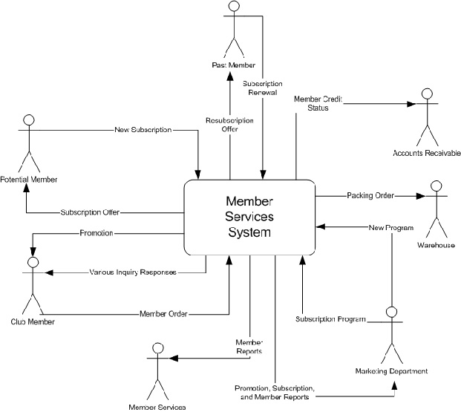
Sample Context Diagram
Notes:
No additional notes

Slide 25
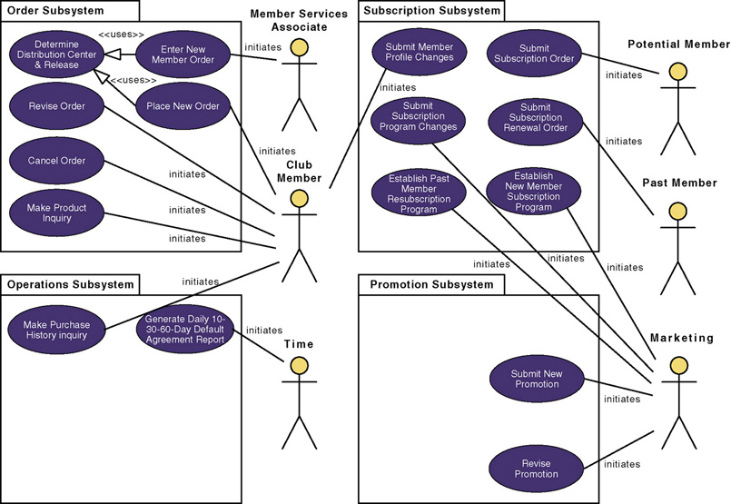
Revised System Use-Case Model Diagram
Notes:
Teaching Notes
A use case model diagram can be used to graphically depict the system scope and boundaries in terms of use cases and actors.
The use case model diagram for the Member Services System is shown in the above figure. It was created using Popkin Software’s System Architect and represents the relationships between the actors and use cases defined for each business subsystem.
The subsystems (UML package symbol) represent logical functional areas of business processes.
The partitioning of system behavior into subsystems is very important in understanding the system architecture and is very key to defining your development strategy — which use cases will be developed first and by whom.

Slide 26
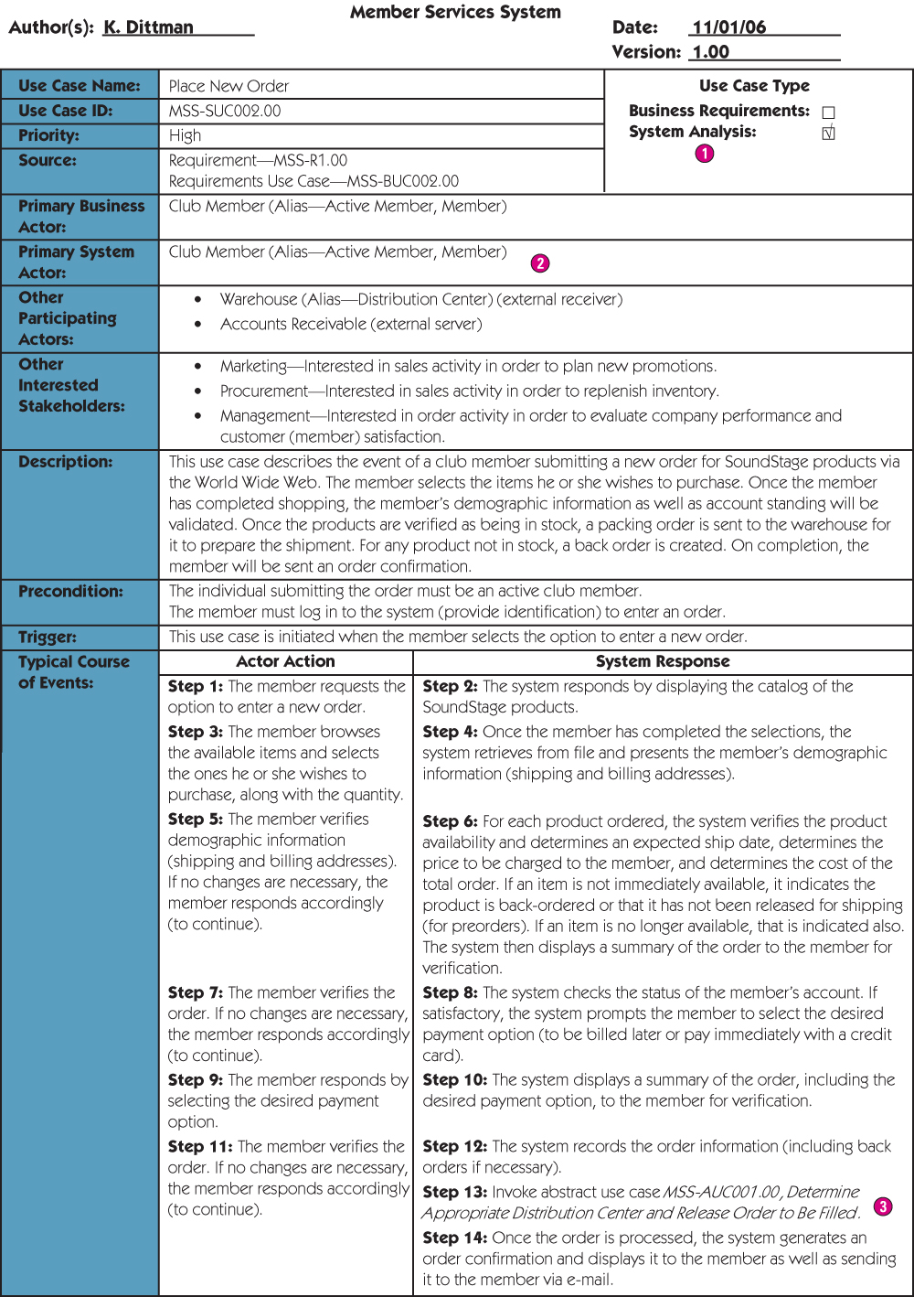
Use-Case Narrative
Notes:
Teaching Notes
If Chapter 6 was covered, this will be review

Slide 27
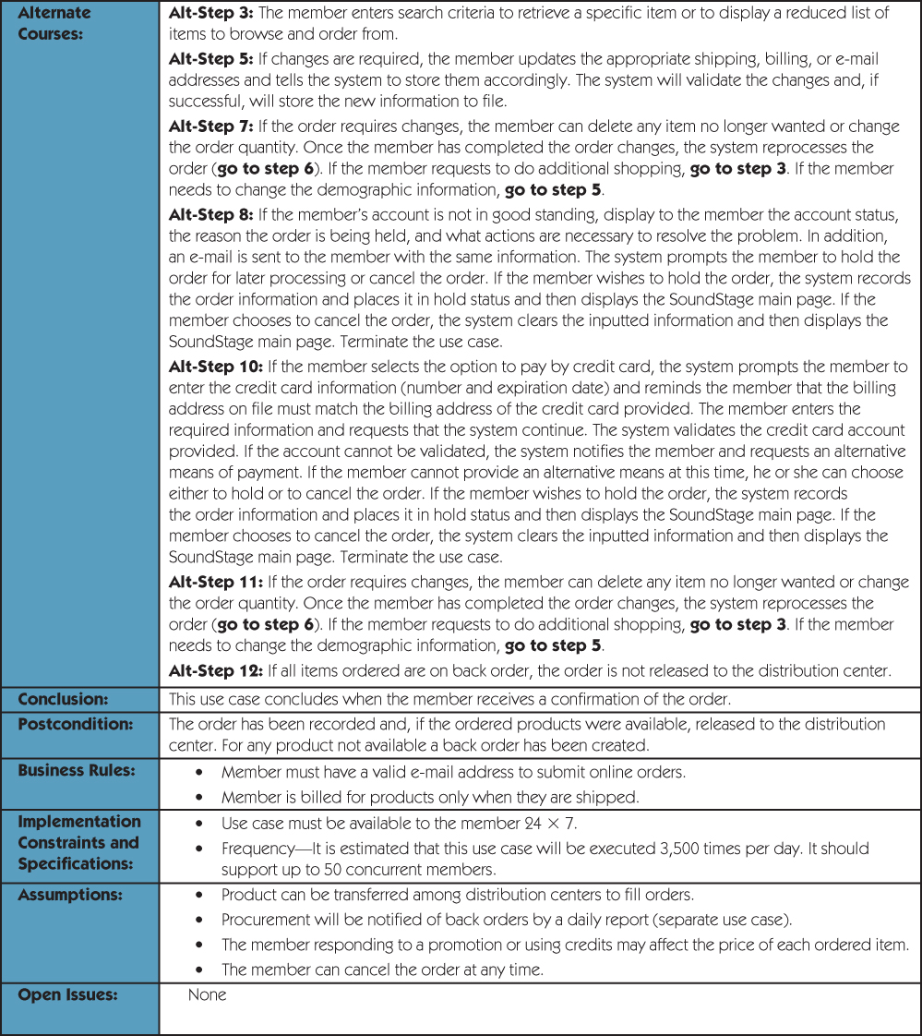
Use-Case Narrative (cont.)
Notes:
Teaching Notes
If Chapter 6 was covered, this will be review

Slide 28
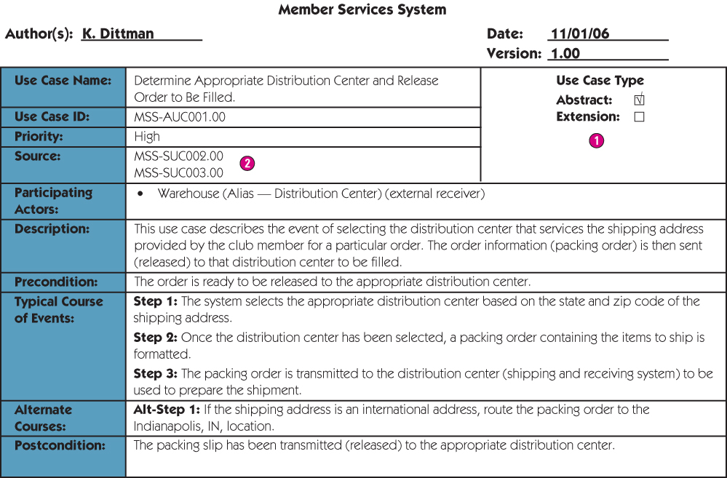
Abstract Use-Case Narrative
Notes:
No additional notes.

Slide 29
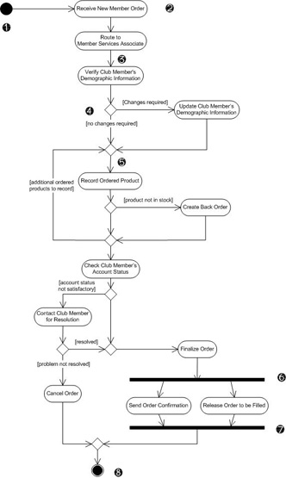
Modeling Use-Case Activities
Activity diagram – a diagram that can be used to graphically depict the flow of a business process, the steps of a use case, or the logic of an object behavior (method).
Notes:
No additional notes.

Slide 30
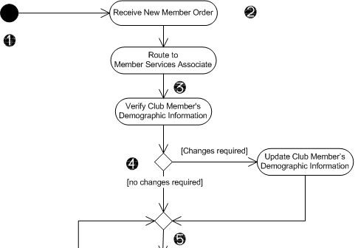
Activity Diagram Notations
Initial node - solid circle representing the start of the process.
Actions – rounded rectangles representing individual steps. The sequence of actions make up the total activity shown by the diagram.
Flow - arrows on the diagram indicating the progression through the actions. Most flows do not need words to identify them unless coming out of decisions.
Decision - diamond shapes with one flow coming in and two or more flows going out. The flows coming out are marked to indicate the conditions.
Merge - diamond shapes with multiple flows coming in and one flow going out. This combines flows previously separated by decisions. Processing continues with any one flow coming into the merge.
Notes:
No additional notes.

Slide 31
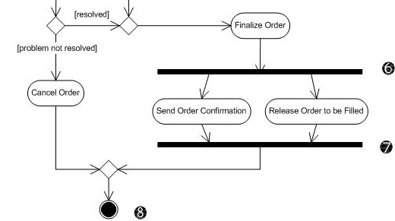
Activity Diagram Notations (cont.)
Fork – a black bar with one flow coming in and two or more flows going out. Actions on parallel flows beneath the fork can occur in any order or concurrently.
Join – a black bar with two or more flows coming in and one flow going out, noting the end of concurrent processing. All actions coming into the join must be completed before processing continues.
Activity final – the solid circle inside the hollow circle representing the end of the process.
Notes:
No additional notes.

Slide 32
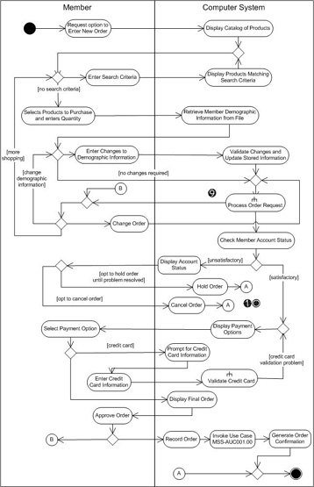
Activity Diagram with Partitions
Subactivity indicator – the rake symbol in an action indicates that this action is broken out in another separate activity diagram. This helps you keep the activity diagram from becoming overly complex.
Connector – A letter inside a circle gives you another tool for managing complexity. A flow coming into a connector jumps to the flow coming out of a connector with a matching letter.
Notes:
Teaching Notes
In addition to the subactivity indicator and the connector, this activity diagram shows partitions (formerly swmlanes). Partitions are especially useful when including receiver actors.

Slide 33
Guidelines for Constructing Activity Diagrams
Start with one initial node as a starting point.
Add partitions if it is relevant to your analysis.
Add an action for each major step of the use case (or each major step an actor initiates.
Add flows from each action to another action, a decision point, or an end point. For maximum precision of meaning, each action should have only one flow coming in and one flow going out with all forks, joins, decisions, and merges shown explicitly.
Add decisions where flows diverge with alternating routes. Be sure to bring them back together with a merge.
Add forks and joins where activities are performed in parallel.
End with a single notation for activity final.
Notes:
No additional notes.

Slide 34
Drawing System Sequence Diagrams
System sequence diagram - a diagram that depicts the interaction between an actor and the system for a use case scenario.
helps identify high-level messages that enter and exit the system
Notes:
Teaching Notes
Emphasize that unlike a context diagram, the system sequence diagram does not try to depict the entire system. It depicts only the interactions for a single scenario of a single use case.

Slide 35
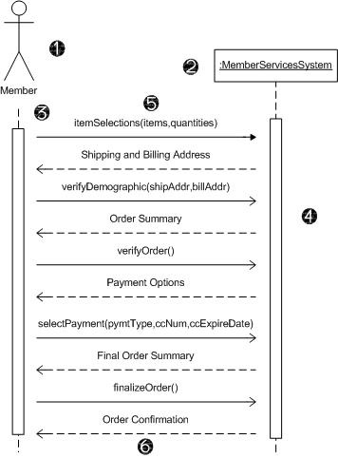
System Sequence Diagram Notations
Actor - the initiating actor of the use case is shown with the use case actor symbol.
System – the box indicates the system as a "black box" or as a whole. The colon (:) is standard sequence diagram notation to indicate a running "instance" of the system.
Lifelines – the dashed vertical lines extending downward from the actor and system symbols, which indicate the life of the sequence.
Activation bars – the bars set over the lifelines indicate period of time when participant is active in the interaction.
Notes:
Teaching Notes
The concepts are the same as with design-level sequence diagrams. But the system appears as a single entity.

Slide 36
System Sequence Diagram Notations (cont.)
Input messages - horizontal arrows from actor to system indicate the message inputs. UML convention for messages is to begin the first word with a lowercase letter and add additional words with initial uppercase letter and no space. In parentheses include parameters, following same naming convention and separated with commas.
Output messages – horizontal arrows from system to actor shown as dashed lines. Since they are web forms, reports, e-mails, etc. these messages do not need to use the standard notation.
Notes:
No additional notes.

Slide 37
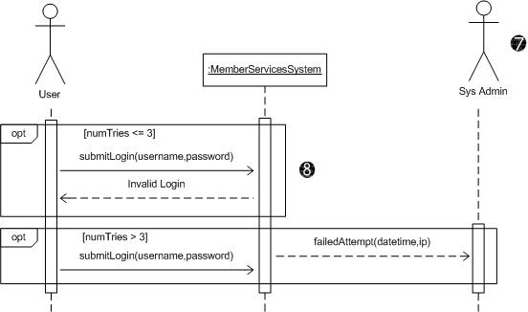
System Sequence Diagram Notations (cont.)
Receiver Actor – other actors or external systems that receive messages from the system can be included.
Frame – a box can enclose one or more messages to divide off a fragment of the sequence. These can show loops, alternate fragments, or optional (opt) steps. For an optional fragment the condition shown in square brackets indicates the conditions under which the steps will be performed.
Notes:
No additional notes.

Slide 38
Guidelines for Constructing System Sequence Diagrams
Identify which scenario of use case you will depict. Purpose is to discover messages, not to model logic. So more important to clearly communicate a single scenario.
Draw a rectangle representing the system as a whole and extend a lifeline under it.
Identify each actor who directly provides an input to the system or directly receives an output from the system. Extend lifelines under the actor(s).
Examine use case narrative to identify system inputs and outputs. Ignore messages inside system. Draw each external message as a horizontal arrow from the actor's lifeline to the system or from the system to the actor. Label inputs according to UML convention.
Add frames to indicate optional messages with conditions. Frames can also indicate loops and alternate fragments.
Confirm that the messages are shown in the proper sequence from top to bottom.
Notes:
No additional notes.

Slide 39
Finding and Identifying the Business Objects
Find the Potential Objects
Review each use case to find nouns that correspond to business entities or events.
Select the Proposed Objects
Not all nouns represent business objects.
Is it a synonym of another object?
Is it outside the scope of the system?
Is it a role without unique behavior, or an external role?
Is it unclear or in need of focus?
Is it an action or an attribute that describes another object?
Notes:
Teaching Notes
Using use cases as a source for finding objects is a popular approach for object identification.

Slide 40
Partial Use-Case Narrative with Nouns Highlighted
Notes:
No additional notes.

Slide 41
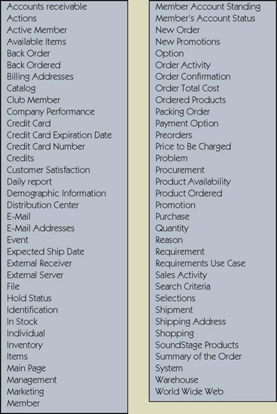
Potential Object List
Notes:
No additional notes.

Slide 42
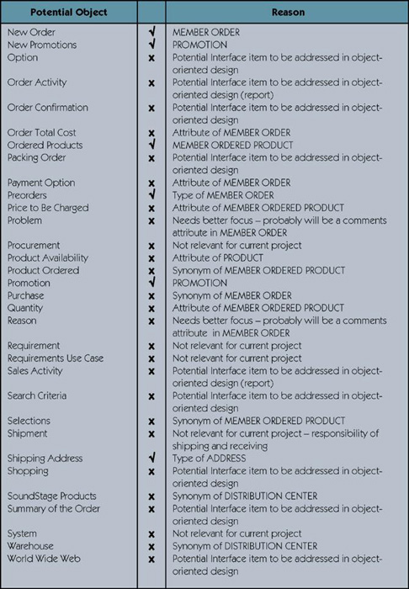
Cleaning Up List of Candidate Objects
Notes:
Teaching Notes
Additional objects were included that are part of the case study but were not identified in the use case. These additional objects are introduced here because they appear in later diagrams.

Slide 43
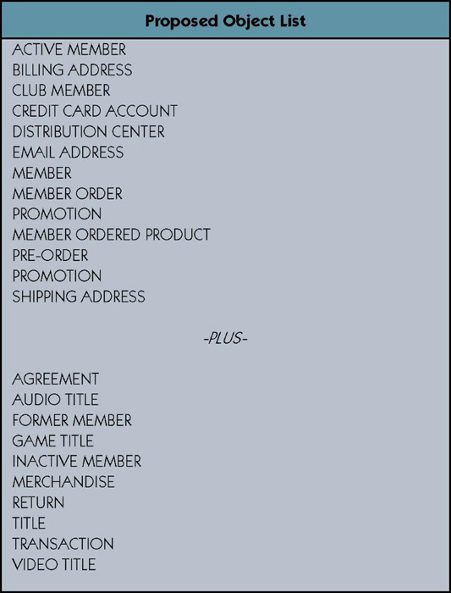
Proposed Object List
Notes:
No additional notes.

Slide 44
Organizing the Objects and Identifying their Relationships
Identifying Associations and Multiplicity
Identifying Generalization/Specialization Relationships
Identifying Aggregation Relationships
Prepare the Class Diagram
Class diagram – a graphical depiction of a system’s static object structure, showing object classes that the system is composed of as well as the relationships between those object classes.
Notes:
Teaching Notes
It is very important that the analyst not only identify relationships that are obvious or recognized by the users. On way to help ensure that possible relationships are identified is to use a object/class matrix. This matrix lists the objects/class as column headings as well as row headings. The matrix can then be used as a check list to ensure that each object/class appearing on a row is checked against each object/class appearing in a column for possible relationships. The name of the relationship and the multiplicity can be recorded directly in the intersection cell of the matrix.
Generalization/Specialization relationships may be discovered by looking at the class diagram. Do any associations exist between two objects that have a one-to-one multiplicity? If so, can you say the sentence “object X is a object Y” and it be true? If it is true, you may have a generalization/specialization relationship. Also look for objects which have common attributes and behaviors. It may be possible to combine the common attributes and behaviors into a new super-object. Why do we want generalization/specialization relationships? It allows us to take advantage of inheritance which facilitates the reuse of objects and programming code.
Aggregation relationships are asymmetric, in that object B is part of Object A but, object A is not part of object B. Aggregation relationships do not imply inheritance, in that object B does not inherit behavior or attributes from object A. Aggregation relationships propagate behavior in that behavior applied to the whole is automatically applied to the parts.

Slide 45
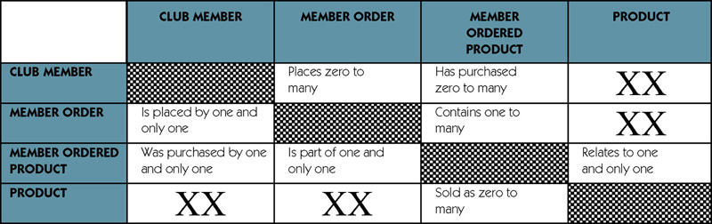
Object Association Matrix
Notes:
Teaching Notes
This tool can be used to record the possible association between any two objects.
To interpret the contents of the cells, start with the object on the left of the row, read the contents of the cell, and then finish with the object at the top of the column. For example:
A CLUB MEMBER places zero to many orders.
A CLUB MEMBER and PRODUCT have no association between them.

Slide 46
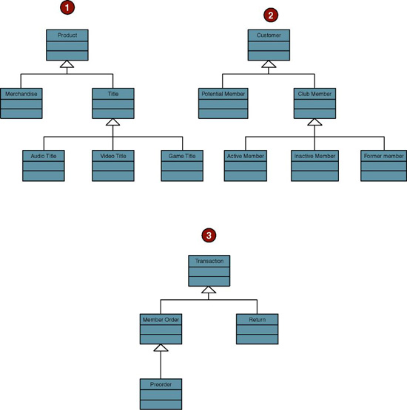
Generalization/Specialization Hierarchies
Notes:
No additional notes.

Slide 47
Persistent and Transient Object Classes
Persistent class – a class that describes an object that outlives the execution of the program that created it.
Stored permanently as in a database
Transient object class – a class that describes an object that is created temporarily by the program and lives only during that program’s execution.
Notes:
No additional notes.

Slide 48
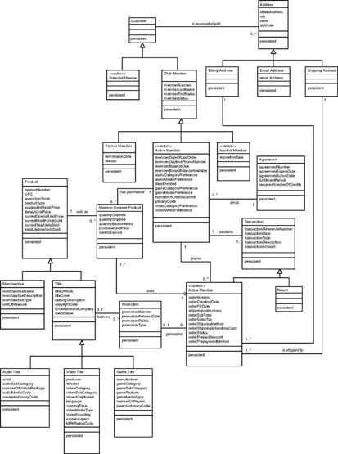
Class Diagram
Refer to Figure 9-24 in text for a more readable copy
Notes:
No additional notes.

